Slide 1
Chapter 6 Counting
Section 2
The Pigeonhole Principle

Slide 2
Outline
Basic Counting Principles
The Inclusion-Exclusion Principle
The Pigeonhole Principle
Ramsey number
Permutations
Combinations
Binomial Coefficients
Generalized Permutations
Combinations with Repetition

Slide 3
The Pigeonhole Principle
The Pigeonhole Principle. (鸽子巢原理)
  Suppose that a flock of 13 pigeons flies into a set of 12 pigeonholes to roost. Thus, at least 1 of these 13 pigeonholes must have at least 2 pigeons
  If each pigeonhole had at most one pigeon in it, then at most 12 pigeons, 1 per hole, could be accommodated
  If there are more pigeons than pigeonholes, then there must be at least 1 pigeonhole with at least 2 pigeons in it

Slide 4
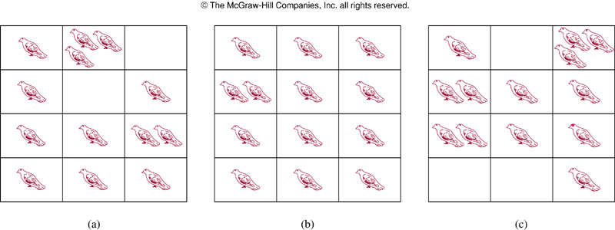
The Pigeonhole Principle
Example.
  A flock of 13 pigeons flies into a set of 12 pigeonholes to roost.

Slide 5
The Pigeonhole Principle
Theorem 1.
  If k is a positive integer and k+1 or more objects are placed into k boxes, then there is at least one box containing two or more of the objects
  Proof.
  Suppose that none of the k boxes contains more than one object. Then the total number of objects would be at most k. This is a contradiction as there are at least k+1 objects
  Also known as Dirichlet drawer principle (狄利克雷抽屉原理)

Slide 6
The Pigeonhole Principle
Corollary 1.
  A function f from a set with k+1 or more elements to a set with k elements is not one-to-one
  Proof.
  Suppose that for each element y in the codomain of f we have a box that contains all elements x of the domain f such that f(x) = y
  As the domain contains k+1 or more elements and the codomain contain only k elements, the pigeonhole principle tells us that one of these boxes contains 2 or more elements x of the domain
  This means that f cannot be one-to-one

Slide 7
The Pigeonhole Principle
Example.
  Among any group of 367 people, there must be at least 2 with the same birthday
  How many students must be in a class to guarantee that at least 2 students receive the same score on the final exam, if the exam is graded on a scale from 0 to 100 points

Slide 8
The Pigeonhole Principle
Theorem 2. (Generalized Pigeonhole Principle)
  If N objects are placed into k boxes, then there is at least one box containing at least ⎡N/k⎤ objects
  Proof.
  Proof by contradiction. Suppose that none of the boxes contains more than ⎡N/k⎤ -1 objects. Then the total number of objects is at most
  k (⎡N/k⎤ -1) < k ((N/k + 1) -1) = N
  where the inequality ⎡N/k⎤ < N/k + 1 is used
  This is a contradiction as there are a total of N objects

Slide 9
The Pigeonhole Principle
Remark.
  A common type of problem asks for the minimum number of objects such that at least r of these objects must be in one of k boxes when these objects are distributed among boxes
  When we have N objects, the generalized pigeonhole principle tells us there must be at least r objects in one of the boxes as long as ⎡N/k⎤ ≥ r. The smallest integer N with N/k + 1 > ⎡N/k⎤ ≥ r, i.e., N = k (r -1) + 1 is the smallest integer satisfying the inequality ⎡N/k⎤ ≥ r

Slide 10
The Pigeonhole Principle
Example.
  Among 100 people there are at least ⎡100/12⎤ = 9 who were born in the same month
  What is the minimum number of students required in a discrete mathematics class to be sure that at least 6 will receive the same grade, if there are 5 possible grades, A, B, C, D, and F?
    The minimum number of students needed to ensure at least 6 students receive the same grade is the smallest integer N such that ⎡N/5⎤ = 6. Thus, the smallest N=5∙5+1=26

Slide 11
The Pigeonhole Principle
Example.
  How many cards must be selected from a standard deck of 52 cards to guarantee that at least 3 cards of the same suit are chosen?
  Solution.
  There are four suits of 13 playing cards (clubs, diamonds, hearts, and spades) in a standard deck
  Suppose there are 4 boxes, one for each suit. If N cards are selected, using the generalized pigeonhole principle, there is at lest one box containing at least ⎡N/4⎤ cards
  Thus to have ⎡N/4⎤ ≥ 3 , the smallest N is 4×(3-1)+1 = 9. So at least 9 cards need to be selected

Slide 12
The Pigeonhole Principle
Example.
  How many cards must be selected to guarantee that at least 3 hearts are selected?
  Solution.
    We do not use the generalized pigeonhole principle to answer this as we want to make sure that there are 3 hearts, not just 3 cards of one suit
  Note in the worst case, we can select all the clubs, diamonds, and spades, 39 cards in all before selecting a single heart
  The next 3 cards will be all hearts, so we may need to select 42 cars to guarantee 3 hearts are selected

Slide 13
The Pigeonhole Principle
Example.
  During a month with 30 days, a baseball team plays no more than 45 games, but at least one game a day in this month. Show that there must be a period of some number of consecutive days during which the team must play exactly 14 games
  Proof.
  Let a_{j} be the number of games played on or before the j-th day of the month. Then a₁, a₂, …, a₃₀ is an increasing sequence of distinct positive integers with 1 ≤a_{j} ≤ 45. Moreover a₁+14, a₂+14, …, a₃₀+14 is also an increasing sequence of distinct positive integers with 1+14 ≤ a_{j}+14 ≤ 45+14, or 15 ≤ a_{j}+14 ≤ 59

Slide 14
The Pigeonhole Principle
Example.
  The 60 positive integers, a₁, a₂, …, a₃₀, a₁+14, a₂+14, …, a₃₀+14 are all less than or equal to 59. Hence, by the pigeonhole principle, two of these integers must be equal, i.e., there must be some i and j, 1 ≤i, j ≤ 30, with a_{i} = a_{j}+14. This means exactly 14 games were played from day j+1 to day i

Slide 15
Ramsey number
Example.
  Assume that in a group of 6 people, each pair of individuals are friends or enemies. Show that there are either 3 mutual friends or 3 mutual enemies in the group
  Let A be one of the 6 people. Of the 5 other people in the group, there are either 3 or more who are friends of A, or 3 or more are enemies of A
  This follows from the generalized pigeonholes principles, as 5 objects are divided into two sets, one of the sets has at least ⎡5/2⎤ = 3 elements

Slide 16
Ramsey number
Ramsey number. (Ramsey数)
  R(m, n) where m and n are positive integers greater than or equal to 2, denotes the minimum number of people at a party such that there are either m mutual friends or n mutual enemies, assuming that every pair of people at the party are friends or enemies
  In the previous example, R(3, 3) ≤ 6. We conclude that R(3,3) = 6 as in a group of 5 people where every two people are friends or enemies, there may not be 3 mutual friends or 3 mutual enemies

Slide 17
Assignment
Exercises.
  Exercises after 5.2: No.32, 40. (Ver.6)

